Slide 1
S is for solid
Handling Changes. Because Reasons.

Slide 2
About me
Software developer for seven years
Worked on many different teams
Worked in Agile (Successful/Challenged)/Waterfall
Worked in ASM to XML
Cares about Software Engineering
Hobbies:
Wife
Three Dogs
Hardware Hacking
Website Building
Giving Talks

Slide 3
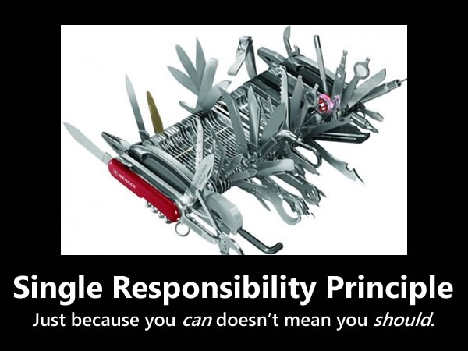
Agenda
Single Responsibility Principle
What is it?
Where did it come from?
Encapsulation
Cohesion
Coupling
Examples
I have brought some from home
Be thinking about other practical examples
Q&A

Slide 4
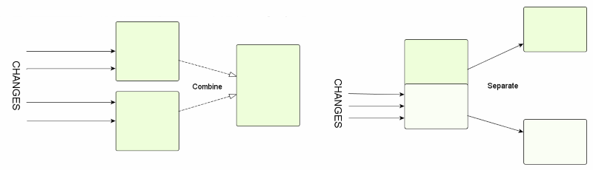
Single Responsibility Principle
“A class should have one and only one reason to change.” – Robert “Uncle Bob” Martin

Slide 5
SRP – Practical definition
“Gather together the things that change for the same reasons. Separate those things that change for different reasons.” – Robert Martin
Original definition says class – Is it limited to classes?
Original definition says reason – What is a reason?
Original definition says change – Is a bug a change? How about a refactor?
I will give you the answers this time!!!

Slide 6

Gathering things - abstraction
We decide what things are when we design software.
We can decide where changes will occur.
We should make cohesive abstractions
We should make responsibility boundaries.

Slide 7

Gathering things - encapsulation
Giving a class reason and a reason
Implemented abstraction
Manages where things happen
If we group reasons we cause coupling
As software matures it may need to expand its implementation.
We base encapsulation on abstraction/ design.
“Responsibility is a family of functions that serves one particular actor.” – Robert Martin

Slide 8

Applied reasoning - cohesion
Organize like things
“Code readability and reusability is increased, while complexity is kept manageable.” – Wikipedia
Types:
Coincidental Cohesion - worst
Logical
Temporal – parts are used at the same time
Procedural – the recipe is always the same
Communication/Information – operate on the same data
Sequential – previous output used for next input
Function
Atomic – best (impractical)

Slide 9
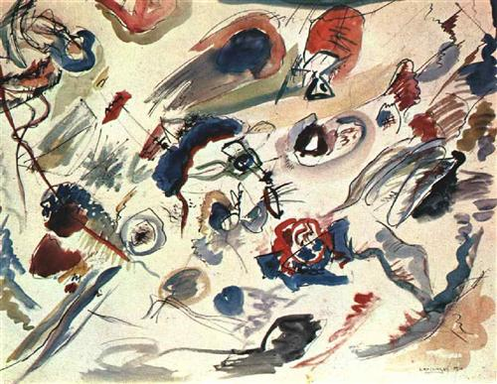
The art of separating - Coupling
Control the knowledge of external components
Transactional integrity may be impacted by implementing loose coupling
new is glue – what happens when the instantiated class changes its behavior?
public class Printer(){
public Printer(){
var formatter = new Formatter();
}
}
Dependency Inversion creates boundaries

Slide 10
Separation of concerns
Modularity – OOP interfaces based programming
Modules encapsulate functionality
Partial classes
After this definitions become circular.

Slide 11
Summary
Each change can be confined to a domain.
Changes are corralled by abstraction and dependency inversion.
Anticlimactic for sure.

Slide 12
Simple example – what is wrong here?
public class Printer {
public void Print (File input) { var formattedText = Format(input.Text); SendToPrinter(formattedText); }
public string Format(string text)…
public void SendToPrinter(string text)…
}
public class FilePrinter { public void Print(File input) { var formatter = new TextFormatter(); var formattedText = formatter.BoldFormat(input.Text); var printer = new DotMatrixPrinter(); printer.Print(formattedText); } }
public class TextFormatter { public string BoldFormat(string text)… … }
public class DotMatrixPrinter : IPrinter { public string Print(string text)… … }

Slide 13
Simple example++
public class FilePrinter { public void PrintBold(IFormatter formatter, IPrinter printer, File input) { var formatter = formatter; var printer = printer; formatter.BoldFormat(input.Text); printer.Print(formatter, input.Text); } }
public class IFormatter { public string BoldFormat(string text)… … }
public class IPrinter { public string Print(IFormatter format, string text)… … }

Slide 14
Example: Awwww crud!
public class Person { string fullName; int id; public void CreatePerson(){…}; public void GetPerson(int id){…}; public void EditPersonName(string fullName, int id){…}; public void DeletePerson(int id){…}; }

Slide 15
CRUD no more?
public class Person { string fullName; int id; IDbContext context; public Person(IDbContext dbConnection){…} public void CreatePerson(){…} public void ReadPerson(int id){…} public void UpdatePersonName(string fullName, int id){…} public void DeletePerson(int id){…} }

Slide 16
Dishwasher
public class Dishwasher { public void HeatWater(){…} public void DispenseSoap(){…} public void Wash(){…} public void Rinse(){…} public void Dry(){…} public void Alert(){…}
}

